Slide 1
Al-Based Internship Recommendation Engine for PM Internship Scheme
Project
First Review
Team Number: ISE_25
Roll Number | Student Nam
20221ISE0162 | Sindhu L Y
20221ISE0171 | Anusha M S
20231ISE3001 | Kumar G K
Under the Supervision of
Dr. Prajeesh C B
Associate Professor
School of Computer Science and Engineering
Presidency University
Name of the Program: Information Science & Engineering​
Name of the HoD: Dr. Gopal Krishna​
Name of the Program Project Coordinator: Ms.Suma N G
Name of the School Project Coordinators: Dr. Sampath A K , Dr. Geetha A

Slide 2
Analysis of Problem Statement
Problem Statement
Introduction
Objectives
Background and Related work for title Selection
Methodology
Analysis of Problem Statement
Existing Methods and Drawbacks
Innovation or Novel Contributions
Git-hub Link
Timeline of the Project
References
Conclusion

Slide 3
Problem Statement Number : SIH25034
Organization: AICTE​ (Smart India Hackathon)
Category : Software
Abstract :
This project proposes an AI-Based Internship Recommendation Engine that utilizes Artificial Intelligence (AI) and Machine Learning (ML) to provide personalized and data-driven internship recommendations. The system analyzes student profiles, including educational background, skills, interests, and career goals, along with internship requirements such as domain, skill set, location, and duration. Based on this analysis, the engine generates ranked internship suggestions that best match individual student profiles.

Slide 4
Introduction
This project is developed in response to SIH25034 under the Smart India Hackathon and is aligned with Sustainable Development Goal 4 (SDG 4 – Quality Education). The solution promotes inclusive and equitable access to experiential learning opportunities, enhances skill development, and supports lifelong learning by connecting students to internships that are most relevant to their learning outcomes and professional growth.
By improving the quality of internship allocation and reducing skill mismatches, the proposed system contributes to better learning experiences, higher employability, and a stronger education-to-employment ecosystem in India

Slide 5
Objectives
To develop an AI-based system that recommends suitable internships to students.
To match students with internships based on their skills, education, and interests.
To reduce skill mismatch between students and internship opportunities.
To provide fair and equal internship recommendations for all students.
To help students gain practical experience relevant to their career goals.
To improve employability by connecting students with industry-relevant internships.
To automate the internship allocation process using data-driven methods.
To support inclusive and quality education under the PM Internship Scheme.

Slide 6
Background and Related work for title Selection
Background
Internships are an essential part of student learning as they help bridge the gap between academic knowledge and real-world industry requirements. The PM Internship Scheme was introduced to provide students with structured internship opportunities and improve employability. However, the increasing number of students and internships makes manual or rule-based allocation inefficient and often inaccurate.
Related work
Existing recommendation systems are widely used in job portals, online learning platforms, and career guidance tools. Most current systems use rule-based filtering or keyword matching, which provides limited personalization. Some studies have explored ML-based career and job recommendation systems using academic data and interest surveys, showing improved matching accuracy.
.

Slide 7
Methodology
The proposed AI-Based Internship Recommendation Engine follows a simple, systematic, and data-driven approach to match students with suitable internships under the PM Internship Scheme. The methodology is designed to be scalable, fair, and easy to understand.
Step-by-Step Methodology
Data Collection
Data Preprocessing
Feature Extraction
Recommendation
EngineRanking & Recommendation
Feedback & Learning

Slide 8
Tools & Software Used
Python – Core programming
VS Code – Development environment
Pandas, NumPy – Data processing
Flask / FastAPI – Backend development
MySQL – Database management
Git & GitHub – Version control

Slide 9
Analysis of Problem Statement
Internship allocation under the PM Internship Scheme is mostly manual or rule-based.
Large number of students makes the process slow and inefficient.
Skill mismatch occurs due to limited consideration of student interests and abilities.
Lack of personalization results in poor internship experiences.
Inequality in access affects students from rural and underprivileged backgrounds.
Existing systems do not effectively use available student and internship data.
Traditional approaches are not scalable for national-level programs.
Need: An AI-based, data-driven system is required to ensure fair, personalized, and scalable internship recommendations aligned with SDG 4 – Quality Education

Slide 10
Existing Methods and Drawbacks
Existing Methods
Manual internship allocation by institutions or authorities
Rule-based filtering using course, eligibility, or location
Basic keyword matching between resumes and internship requirements
First-come or merit-based selection methods
Drawbacks
Time-consuming and difficult to manage at large scale
Poor skill-to-internship matching
No personalization based on student interests and goals
Possibility of bias and unequal access to opportunities
Inefficient use of available student and internship data
Not suitable for large programs like the PM Internship Scheme

Slide 11
Innovation / Novel Contributions
AI-driven internship matching instead of manual or rule-based selection
Personalized recommendations based on skills, interests, and career goals
Fair and unbiased allocation ensuring equal opportunities for all students
Government-scale recommendation system designed for the PM Internship Scheme
Continuous learning using student feedback to improve accuracy
Skill-focused matching rather than only academic qualifications
Strong alignment with SDG 4 – Quality Education
Scalable and transparent system suitable for national deployment

Slide 12
Git-hub Link
https://github.com/Sindhu9ly/ISE_25

Slide 13
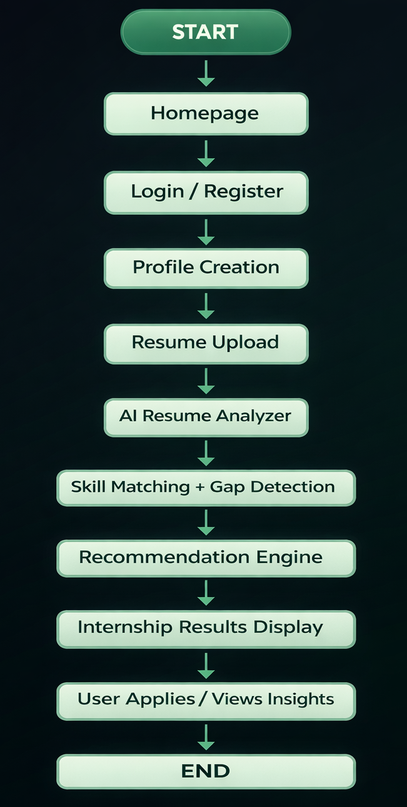
Flow Diagram

Slide 14
Timeline of the Project
Sl. No. | Activity | Start Date | End Date
1 | Review – 1 | 10-01-2026 | 16-01-2026
2 | Review – 2 | 31-01-2026 | 06-02-2026
3 | Review – 3 | 28-02-2026 | 06-03-2026
4 | Review – 4 | 03-04-2026 | 09-04-2026
5 | Final Viva | 20-04-2026 | 26-04-2026

Slide 15
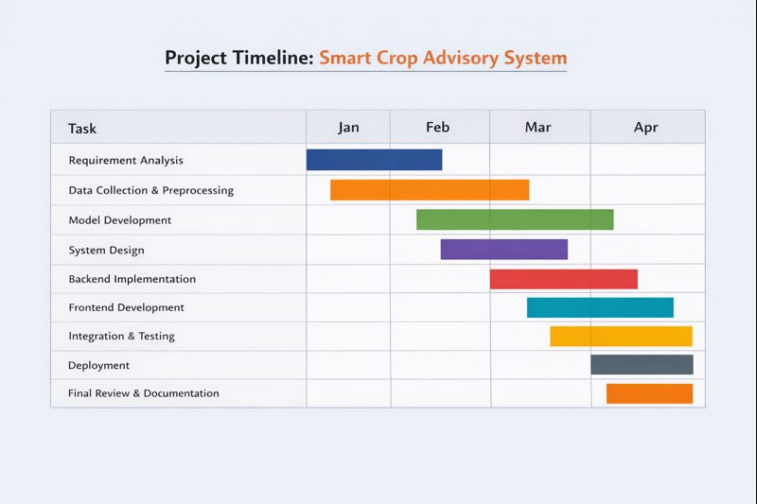
Timeline of the Project (Gantt Chart)

Slide 16
References
Government of India, PM Internship Scheme, Official Portal.
T. Ahmed and M. Kadam, “AI-Based Internship Recommendation Engine for Government Internship Schemes,” ResearchGate, 2024.
J. Doe and A. Smith, “Title of the Paper,” International Research Journal of Modern Engineering and Technology Society (IRJMETS), 2024.
F. P. Poncio, “Navigating techniques in job recommender systems on internship profile matching: a systematic review,” Journal of Research in Innovative Teaching & Learning, vol. 17, no. 2, pp. 352–367, Aug. 2024.
AI Internship Recommendation System”, International Journal of Research and Production, vol. 6, no. 11, pp. 56100, 2025.
Y. Mao, S. Lin, and Y. Cheng, “A Job Recommendation Model Based on a Two-Layer Attention Mechanism,” Electronics, vol. 13, no. 3, p. 485, 2024.

Slide 17
Conclusion
The AI-Based Internship Recommendation Engine provides a fair, scalable, and data-driven solution for internship allocation under the PM Internship Scheme by leveraging AI and Machine Learning for accurate skill-based matching. It reduces manual effort, minimizes skill mismatches, and ensures equal access to opportunities for students from diverse backgrounds. The system enhances employability by aligning academic learning with industry requirements and strongly supports SDG 4 – Quality Education. Overall, the solution is transparent, adaptable, and suitable for large-scale government deployment, demonstrating the potential of AI in strengthening the education-to-employment ecosystem in India.

Slide 18


